Slide 1

Let’s Talk Careers

Slide 2


Slide 3
Health Science
Nursing
Certified Nursing Assistant (CNA)
Emergency Room Nurse
Intensive Care Unit Nurse
Doctor / Physician
Respiratory Therapist
Pharmacist / Pharmacy Technician

Slide 4
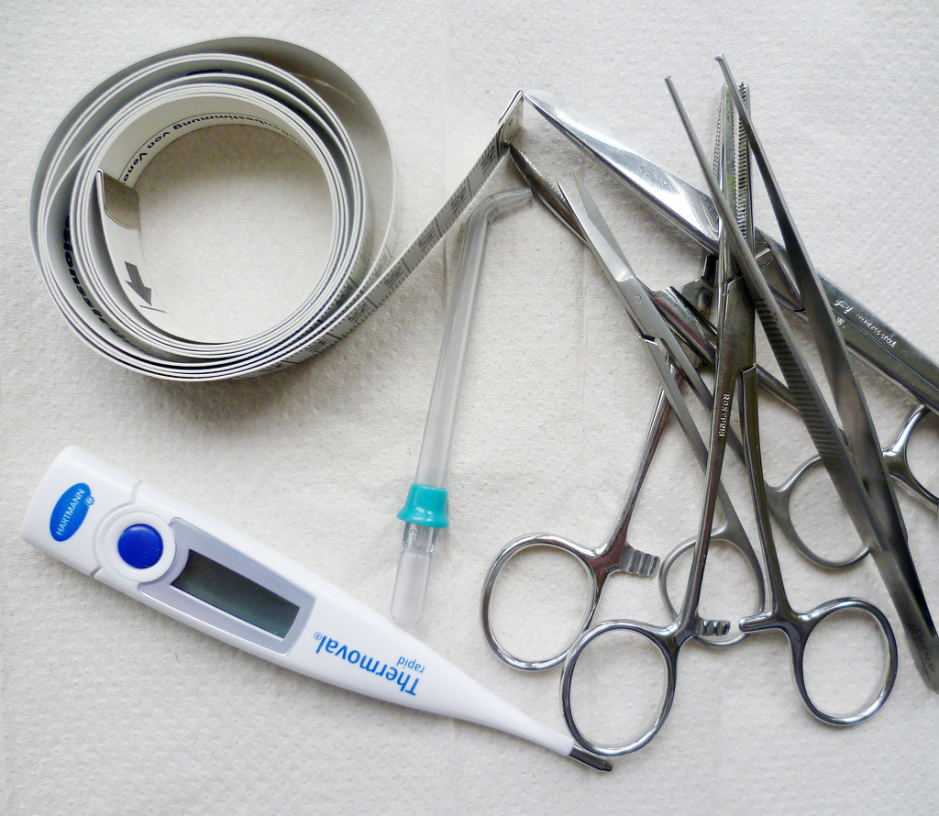
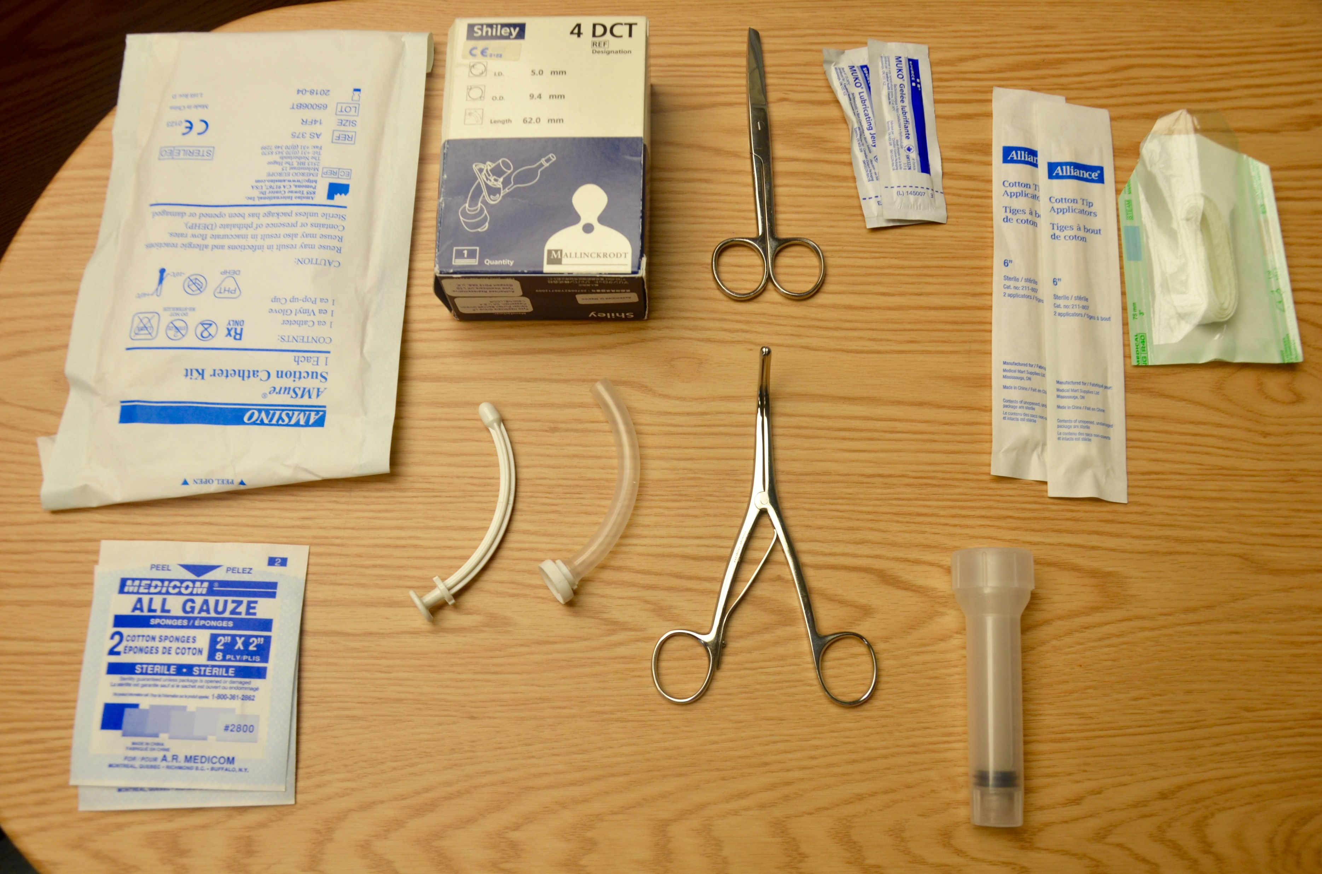

Health Science
Tools
Certified Nursing Assistant
  Salary: $20,000 - $37,000
  Education: 4-12 week program
  Work environment: hospitals, nursing homes, home healthcare, retirement communities
Emergency Room Nurse / Intensive Care Unit
  Salary: $40,000 - $102,000
  Education: 2 or 4 year college degree
  Work environment: hospitals, doctor’s offices, residential care, schools, home healthcare

Slide 5
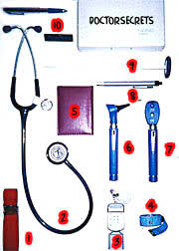
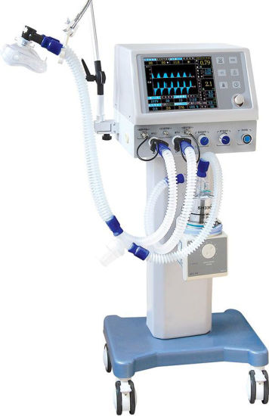
Health Science
Tools
Doctor / Physician
  Salary: $339,000 (average)
  Education: 4-year Bachelor’s degree, 4-year Medical School degree, AND 3-7 years of specialization training
  Work environment: hospitals, medical clinics, doctor’s offices
Respiratory Therapist
  Salary: $43,000 - $86,000
  Education: 2 or 4 year college degree
  Work environment: hospitals, nursing care facilities, doctor’s offices

Slide 6


Health Science
Pharmacist
  Salary: $70,000 - $150,000
  Education: 4-year Bachelor’s degree AND a 4-year Doctor of Pharmacy degree
  Work environment: pharmacies and hospitals
Pharmacy Technician
  Salary: $21,000 - $45,000
  Education: certification or a 1-2 year college program and on-the-job training
  Work environment: pharmacies and hospitals
Tools

Slide 7
Law, Public Safety, Corrections, and Security
Police Officers
Correctional Officers
911 Call Taker / Dispatcher
Emergency Medical Technician / Paramedic

Slide 8


Officers
Tools
Police Officer
  Salary: $34,000 - $101,000
  Education: high school diploma or GED and policy academy program, and 2-4 year college degree (optional)
  Work environment: police stations, squad cars, and government agencies
Correctional Officer
  Salary: $24,000 - $78,000
  Education: high school diploma or GED and a training academy
  Work environment: jails, prisons, courtrooms, transportation vehicles

Slide 9

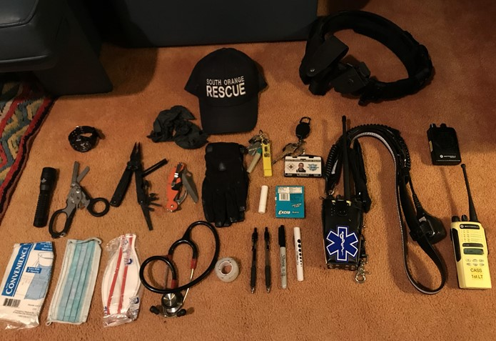
Emergency Personnel
911 Call Taker / Dispatcher
  Salary: $25,000 - $61,000
  Education: high school diploma or GED
  Work environment: public safety communication department
Emergency Medical Technician
  Salary: $21,000 - $56,000
  Education: 1-year EMT program and 1-year paramedic program
  Work environment: ambulance services, hospitals, and government
Paramedic
  Salary: $31,000 - $67,000
  Education: 2-year college paramedic program
  Work environment: ambulance services, hospitals, and government
Tools

Slide 10
Other
Essential Careers
During
COVID-19
Cashier / Grocer
Farmer
Truck Driver

Slide 11



Essential Careers
Cashier / Grocer
  Salary: $8-$14 an hour
  Education: high school diploma or GED
  Work environment: retail, grocery store, utility company, gas station
Farmer
  Salary: $30,000 - $126,000
  Education: no formal education required (2-4 year agricultural college degree optional)
  Work environment: farms
Truck Driver
  Salary: $60,175 (average)
  Education: Commercials Drivers License, CDL Training School (7-12 week program)
  Work environment: semi-truck, travel
Tools

